Slide 1
Impact of Globalization on Economic Growth
Thesis Presentation
Presented by: Abdul Rehman Shoukat

Slide 2
Introduction
It basically analyzes that how the world becoming a global village has led to the increase in the Gross Domestic Product of each country which indulges in Globalization.
There is a direct relationship among Economic growth and globalization as all the economies of the world have their own competitive advantage and to take advantage of it, they exchange goods with the international market.
Globalization impacts the society in both good and bad ways. In adverse effects there are more chances of price instability, exchange rate fluctuations, and job insecurities. In good, it leads to access to higher education leading to a reduction in illiteracy in these countries.
Globalization impacts entire economies both Developing and Developed Economies play an important subsidiary affected by Global trading leading to high GDP growth.
Policy Makers on National and International Level have also led, to a huge impact on the globalization and trade policy of different countries causing a fall and rise in their GDP Per Capita.
perception of society about Globalization like some Islamic Countries do not consider trading with countries who are abusive to their societal values causing the society to dislike Globalization causing less Economic growth, so the stakeholders are Countries (Both developing and developed), Industrialist all over the world, and Governments of different economies.

Slide 3
Literature Review (Theoretical)
Lucas, 2000
The Investment or money did not actually move from the rich developed countries to the poor developing countries and with time will evaporate from those economies.
The countries who follow the catch-up strategy will nurture way higher than those reached by the East Asian Countries also known as “The Lucas Paradox”
Hence the Lucas Paradox Model claims that as the Capital is mobile it will be transferred to the poorer countries at a later date then the leader so when the technology is transferred to the poorer developed countries they start to grow at the fastest rate but later on in time they grow according to the percentage change with the income gap of the leader.
we can say that Globalization does lead to economic growth in the poorer countries but as there is a time lag between the transfer among the leader and the developing economy. So, the capital will stay the same between rich and poor countries so overall it did not move from the rich country to the poorer country.

Slide 4
Literature Review (Theoretical)
Gerschenkron, 1962
The theory states that when the government is proactive it will lead to the government being able to help an economy escape from market failures and constant financial markets as they are all being monitored by the institution which is the government here.
they can also help infant industries to stand on their feet by giving them financial help and technical assistance as compared to complete interdependence on the market forces
Crafts, 2004
Hence Leading to Growth in the economy and helping them meet the global industry standards and size leading to a huge growth in the Economies GDP. However, this is only applicable if the transition is to fully compete with globalized capital markets.
Prebisch-Suinger thesis is a hypothesis which became famous in the developing nations laws in the coming years. The terms of trade will never be in favor of Primary goods producers.
the developing country or a third world country which are heavily dependent on Agricultural produce will never be able to get the same benefit from globalization as much a producer of manufactured goods will be able to benefit from globalization as it is a developed country.

Slide 5
Literature Review (Theoretical)
Solow, 1957
A technological change will lead to a shift in the production equation instead of movement in it. Further it states that due to a technological change of 80% in the worker output.
Hence the neo-classical theory of Solow states a technological change will lead to more output leading to more economic growth.
Technology is mobile in the global world and ease of getting technological equipment will lead to globalization, so we can say that globalization will lead to economic growth in current world according to Solow Growth Model.

Slide 6
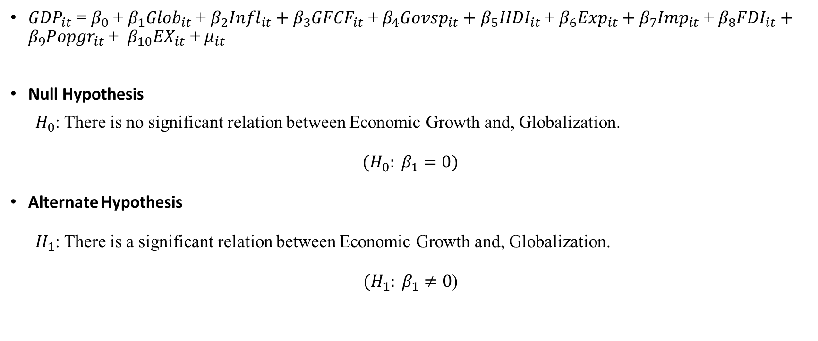
Model-Equation-Hypothesis
${GDP}_{it}$ = $β_{0}$ + $β_{1}{Glob}_{it}$ + $β_{2}{Infl}_{it}+$ $β_{3}{GFCF}_{it}$ + $β_{4}{Govsp}_{it}+$ $β_{5}{HDI}_{it}$ + $β_{6}{Exp}_{it}+$ $β_{7}{Imp}_{it}$ + $β_{8}{FDI}_{it}+$ $β_{9}{Popgr}_{it}$ + $β_{10}{EX}_{it}$ + $μ_{it}$
Null Hypothesis
$"H_{0}$: There is no significant relation between Economic Growth and, Globalization.”
$$(H_{0}: β_{1}=0)$$
Alternate Hypothesis
$"H_{1}$: There is a significant relation between Economic Growth and, Globalization.”
$(H_{1}: β_{1}≠0$)

Slide 7
Sr. | Var. Name | Var. Abbreviation | Quantification | Data Source
1 | Economic Growth | GDP | GDP, PPP (current international $ | WDI
2 | Globalization | Globalization | KOF Globalization Index in Units | KOF Swiss economic Institute
3 | Inflation | Inflation | Inflation, consumer prices (annual % | WDI
4 | Gross-Fixed Capital Formation | GFCF | Gross fixed capital formation in $s | WDI
5 | Government Spending | Government Spending | General government final consumption expenditure in $s | WDI
6 | Human Development Index | Human Development Index | Life Expectancy in Years, Age Dependency in Years, | WDI
7 | Years-of Education | Secondary Education, Primary Education | In Years duration | WDI
8 | Life Expectancy | Life Expectancy | Life expectancy at birth, total (years) | WDI
9 | Exports | Exports | Exports of goods and services in $s | WDI
10 | Imports | Imports | Imports of goods and services in $s | WDI
11 | Foreign Direct Investment | FDI | Foreign direct investment, net in $s | WDI
12 | Age Dependency | Age Dependency | Age dependency ratio (% of working-age population) | WDI
13 | Population Growth | Population Growth | Annual % | WDI
14 | Exchange Rate | EXRate | Exchange Rate in $s | WDI
15 | Dummy for UIC and LIC | LLI | LLI=1 for UIC, 0 for LIC

Slide 8
Summary Statistics: Overall
Table 1a:
Summary Statistics: Overall
Variable |  | Mean | SD | Min | Max | Observations
GDP | Overall | 8.86E+11 | 2.47E+12 | 1.41E+08 | 2.73E+13 | N = 1000
 | between |  | 2.27E+12 | 2.00E+08 | 1.44E+13 | n = 50
 | Within |  | 1.03E+12 | -8.97E+12 | 1.38E+13 | T = 20
Globalization | Overall | 57.88987 | 13.37251 | 24 | 86.87365 | N = 1000
 | between |  | 12.94419 | 34.46667 | 84.51963 | n = 50
 | Within |  | 3.80245 | 41.59456 | 66.18837 | T = 20

Slide 9
Summary Statistics: Lower Income Countries
Table 1b
Summary Statistics: Lower Income Countries
Variable |  | Mean | SD | Min | Max | Observations
GDP | Overall | 2.05E+11 | 2.72E+11 | 1.41E+08 | 1.33E+12 | N = 840
 | between |  | 2.53E+11 | 2.00E+08 | 8.60E+11 | n = 42
 | Within |  | 1.06E+11 | -2.18E+11 | 7.45E+11 | T = 20
Globalization | Overall | 56.17689 | 13.55097 | 24 | 86.87365 | N = 840
 | between |  | 13.12178 | 34.46667 | 84.51963 | n = 42
 | Within |  | 3.91751 | 39.88158 | 64.4754 | T = 20

Slide 10
Summary Statistics: Upper Income Countries
Table 1c
Summary Statistics: Upper Income Countries
Variable |  | Mean | SD | Min | Max | Observations
GDP | Overall | 4.46E+12 | 4.77E+12 | 6.12E+11 | 2.73E+13 | N = 160
 | between |  | 4.29E+12 | 1.54E+12 | 1.44E+13 | n = 8
 | Within |  | 2.57E+12 | -5.39E+12 | 1.74E+13 | T = 20
Globalization | Overall | 66.88301 | 7.596548 | 50.78316 | 83.27389 | N = 160
 | between |  | 7.371455 | 59.43063 | 81.23455 | n = 8
 | Within |  | 3.140455 | 58.23555 | 72.42953 | T = 20

Slide 11
Correlation Matrix
Overall
Upper Income Countries
Variables | (1) | (2)
(1) GDP | 1.000
(2) Globalization | 0.195 | 1.000
Variables | (1) | (2)
(1) GDP | 1.000
(2) Globalization | -0.137 | 1.000
Upper Income Countries
Variables | (1) | (2)
(1) GDP | 1.000
(2) Globalization | 0.358 | 1.000

Slide 12
T-test of Mean Comparison
T-Test of mean-comparison at a 95% Confidence Interval: Upper Income and Lower Income Countries
50 Developing Countries Data
Variables | T Stat
GDP | 25.65
Inflation | -1.3
GFCF | 8.05
Government Spending | 8.65
Life Expectancy | 9.3
Secondary Education | -0.15
Primary Education | -3.35
Exports | 3.5
Imports | 3.4
Foreign Direct Investment | -4.9
Population Growth | -4.4
Exchange Rate | -0.6
Globalization | 9.7
Age Dependency | -4.05
H₀: no significant difference between means of the variables in Upper Income Countries and Lower Income Countries.
H₁: significant difference between means of the variables in Upper Income Countries and Lower Income Countries.

Slide 13
Descriptive (Average 2021)
Figure 1m
Pie chart: Average KOF Globalization

Slide 14
Descriptive: Globalization (2002-2021)
Figure 2k
Line Chart: Globalization KOF

Slide 15
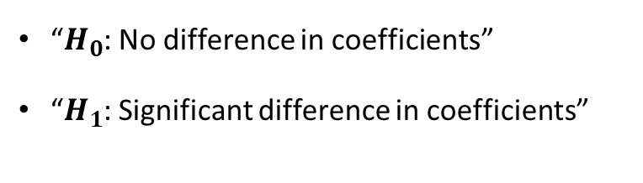
Hausman for Overall Fixed Regression Model
Hausman (1978) specification test
 | Coef.
Chi-square test value | 21.116
P-value | 0.004
“$H_{0}$: No difference in coefficients”
“$H_{1}$: Significant difference in coefficients”

Slide 16
Regression
Overall FE Regression
VARIABLES | GDP(FE) | GDP(i.Time) | GDP(Robust)
Globalization | 3.003e+10** | -2.537e+10 | 3.003e+10
 | (1.271e+10) | (1.802e+10) | (2.149e+10)
VARIABLES | GDP(FE) | GDP(i.Time) | GDP(Robust)
Globalization | 2.370e+09** | -8.437e+09*** | 2.370e+09
 | (1.139e+09) | (1.443e+09) | (2.765e+09)
Lower Income Countries FE
VARIABLES | GDP(RE) | GDP(Robust)
Globalization | -3.744e+11*** | -3.744e+11***
 | (1.014e+11) | (1.434e+11)
Upper Income Countries

Slide 17
Policy Recommendation
There should be sustainable policies aiming at the future which directly leads to growth in the country by income provisions, & spending on people which will eventually lead to a decrease of negative impacts on income distribution.
Growing emphasis on digitalization and automation: As technology develops, governments will probably place more of an emphasis on advancing digitalization and automation in order to boost economic growth,
leading to increased emphasis on spending on programmers for education and training, research and development, and infrastructure that supports digital technologies

Slide 18
Policy Recommendation
More nationalism and protectionism: In recent years, there has been an increase in nationalism and protectionism, with some nations enacting laws that restrict migration and commerce internationally.
This pattern is most likely to persist, which could result in slower economic expansion and more geopolitical tensions.
As developing economies like China and India continue to expand, the balance of economic power in the world is changing.
This can result in modifications to trade and investment trends as well as changes to the geopolitical environment.

Slide 19
Implication
We could have included more countries and more time periods to get more accurate data.
It could have been conducted for different regions instead of UIC and LIC it would have given us a geographical outlook too.
Number of observations could have been increase to 2000 or 3000 for better accuracy.
There can be a biased result as we used only Thirteen independent Variables and one dependent. The results could benefit to countries to keep a check on the factors that lead to losses on their Net GDP and take out policies to reduce those losses.
This particular study can also be used as empirical evidence for future researchers and studies to help them get more accurate data.
IV (Instrumental Variables) could also have been used in the study, but they can be used in future studies to increase accuracy.

Slide 20
Conclusion
Overall result, we can see that there is a 5% significant impact of Globalization, & Age Dependency on GDP. A 1 % impact of Life Expectancy, and Primary Education in GDP.
The Inflation, GFCF, Government Spending, Secondary Education, Exports, Imports, Population Growth & Exchange Rate are insignificant in the overall result.
In Overall Regression in case of Foreign Direct Investment an increase in FDI shows a decrease in GDP, which is very unusable from the normal definition.
there is a lot of Gap based on incomes, living standards among the people of Upper Income Countries and Lower Income Countries.
Our analysis helps us see that how a change in our independent variables led to an impact of the GDP of these Upper Income and Lower Income Countries.

Slide 21
Thank You

